Slide 1




NEXT GEN EMPLOYABILITY PROGRAM
Creating a future-ready workforce
Team Members
College Name
Student Name :R.thamizharasi
Student ID : aut421621104156
VRSCET

Slide 2

CAPSTONE PROJECT SHOWCASE
Project Title
Car Rentals Application with Django Framework
Abstract | Problem Statement | Project Overview | Proposed Solution | Technology Used | Modelling & Results | Conclusion

Slide 3
Abstract
This project aims to develop a comprehensive car rentals application using the Django framework, a high-level Python web framework renowned for its simplicity, flexibility, and scalability. The application facilitates the rental of vehicles to users through a user-friendly web interface, providing features for browsing, booking, and managing rental transactions.
Key components of the application include user authentication and authorization mechanisms, allowing users to register, log in, and manage their accounts securely. A robust vehicle management system enables administrators to add, update, and remove vehicles from the rental fleet, each with detailed attributes such as make, model, availability, and pricing information.
Source :

Slide 4
Problem Statement
The primary objective of this project is to develop a comprehensive car rentals application that leverages the capabilities of Django to streamline the rental process, improve vehicle management, and enhance user satisfaction. The application will serve as a centralized platform where users can easily search for available vehicles, make bookings, manage reservations, and complete rental transactions seamlessly.
Challenges addressed by the application
Need for modernized rental solutions
Benefits of leveraging Django framework
Source :

Slide 5
Project Overview
Users can search for available vehicles based on location, date, time, and vehicle type. They can then proceed to book or reserve vehicles for specific durations. Our booking system integrates with third-party calendar APIs to ensure real-time availability updates and prevent overbooking. We integrate with leading payment gateways to facilitate secure and convenient payment processing for rental transactions. Users can make payments using credit/debit cards, PayPal, or other supported payment methods, ensuring a seamless checkout experience.
Source :

Slide 6
Proposed Solution
Our proposed solution for the Car Rentals Application aims to provide a comprehensive and user-friendly platform for both rental agencies and customers, leveraging the Django framework for its robustness, flexibility, and scalability. Implement a user authentication system that allows users to register, log in, and manage their accounts securely. This includes features such as password reset, profile management, and role-based access control. Create a booking and reservation system that allows users to search for available vehicles based on location, date, time, and vehicle type. Users should be able to make bookings or reservations for specific durations, with real-time availability updates to prevent overbooking.
.
overview of the key components and features of our proposed solution:
Source :

Slide 7
User Authentication and Registration: Implement a user authentication system allows users to register, log in, and manage their accounts securely.
Vehicle Management: Develop a robust vehicle management system that enables rental agencies to add, update, and remove vehicles from their fleet.
Booking and Reservation System: Create a booking and reservation system that allows users to search for available vehicles based on location, date, time, and vehicle type.
:
Payment Integration: Integrate with popular payment gateways to facilitate secure and convenient payment processing for rental transactions.
Source :

Slide 8
Notifications: Implement automatic notifications to keep users informed throughout the rental process. This includes sending booking confirmations, reminders, updates on rental status, and payment receipts via email or SMS.
Admin Dashboard: Develop a powerful admin dashboard that provides rental agencies with insights into their rental operations.
Rating and Reviews: Enable users to rate and review their rental experience, providing valuable feedback for both rental agencies and other users.
Search and Filtering: Implement advanced search and filtering functionalities to help users find the perfect rental vehicle.
Source :

Slide 9


Technology Used
Front-end
Back-end
Source :

Slide 10
Modelling & Results
Data Modeling:
a. Entities (Models)
b. Relationships
c. Attributes and Constraints
Results:
User Engagement: Measure how many people are signing up, logging in, and actively using the app
Market Growth: Keep an eye on how the app is expanding to new regions or attracting more users. This shows the potential for growth and market reach.
Revenue: Calculate the total amount of money generated from rental bookings.
Source :

Slide 11
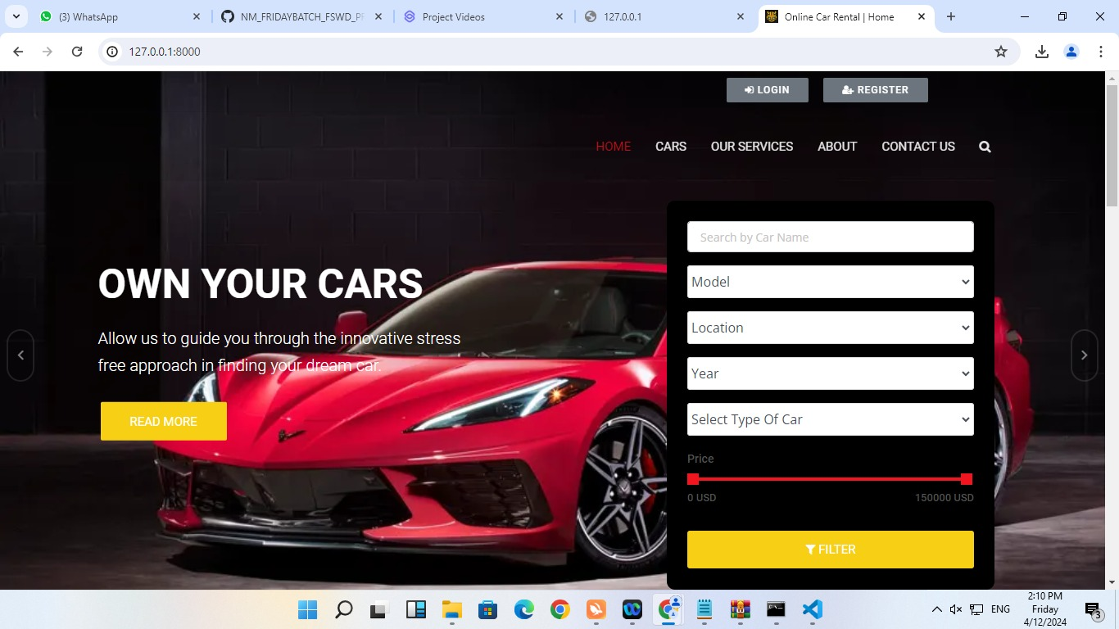
Homepage

Slide 12
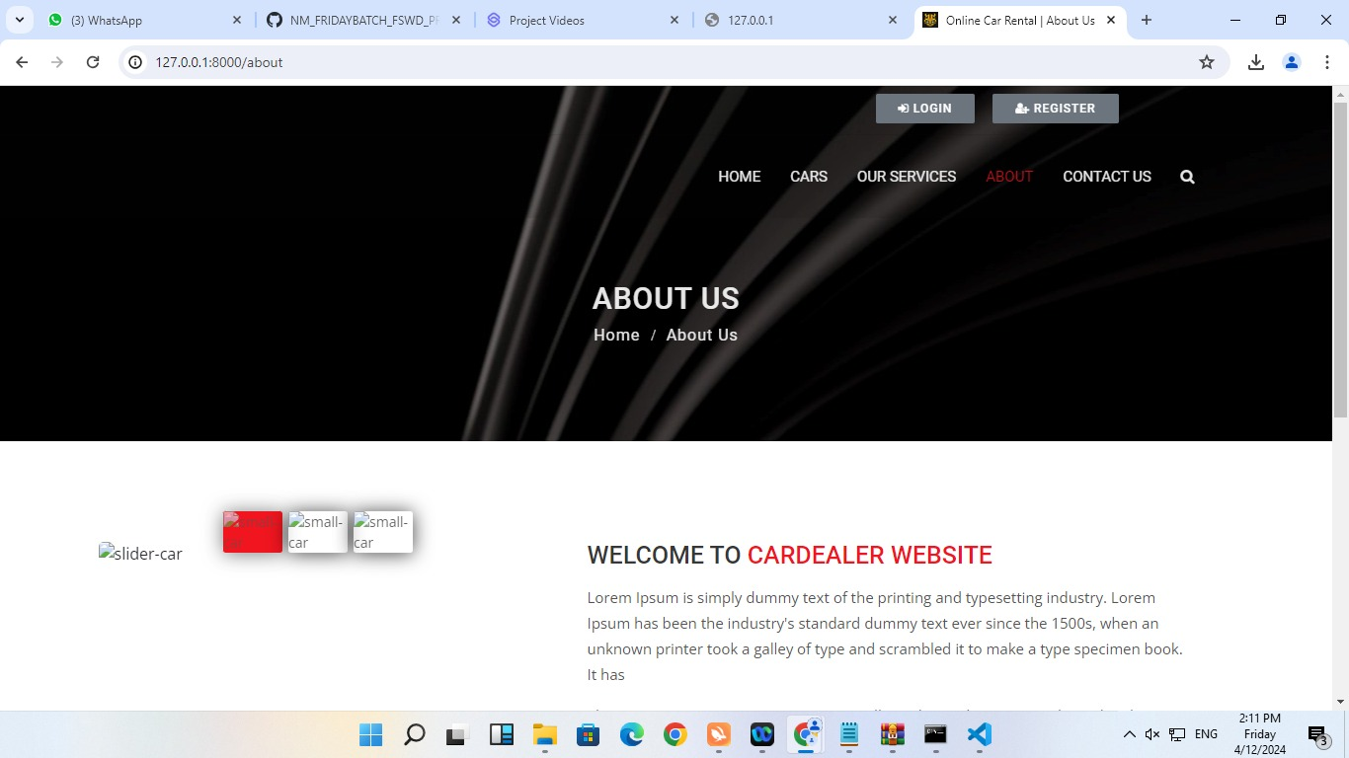
About-Us-Page

Slide 13
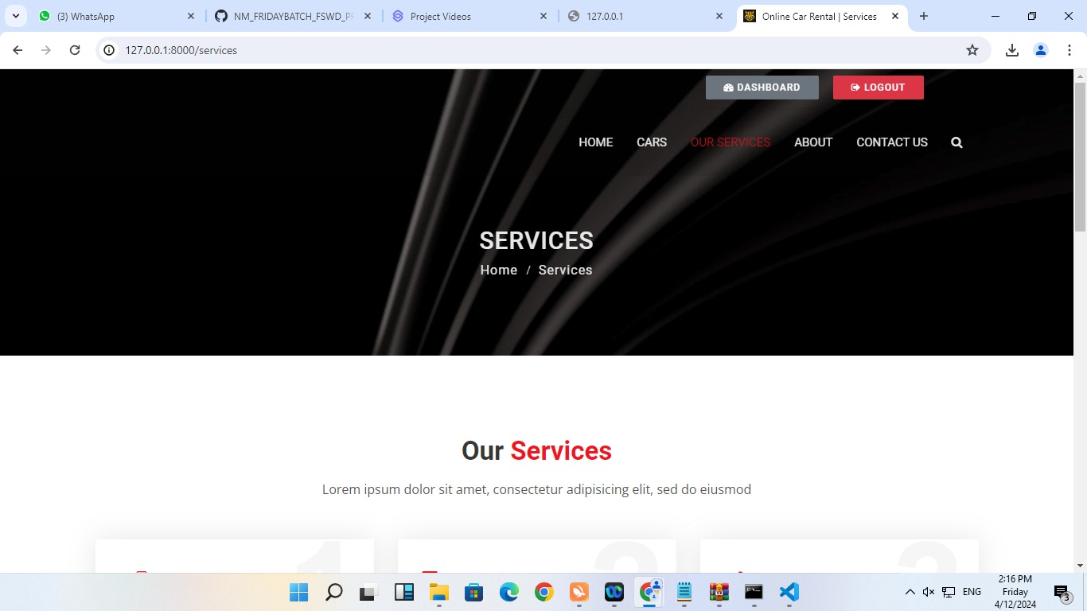
Service-Page

Slide 14
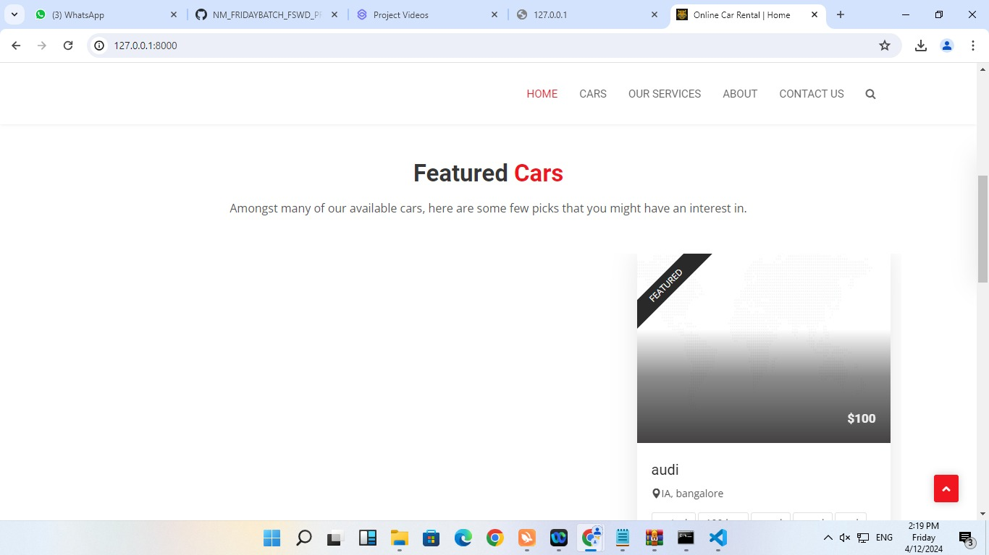
Departments-Page
:

Slide 15
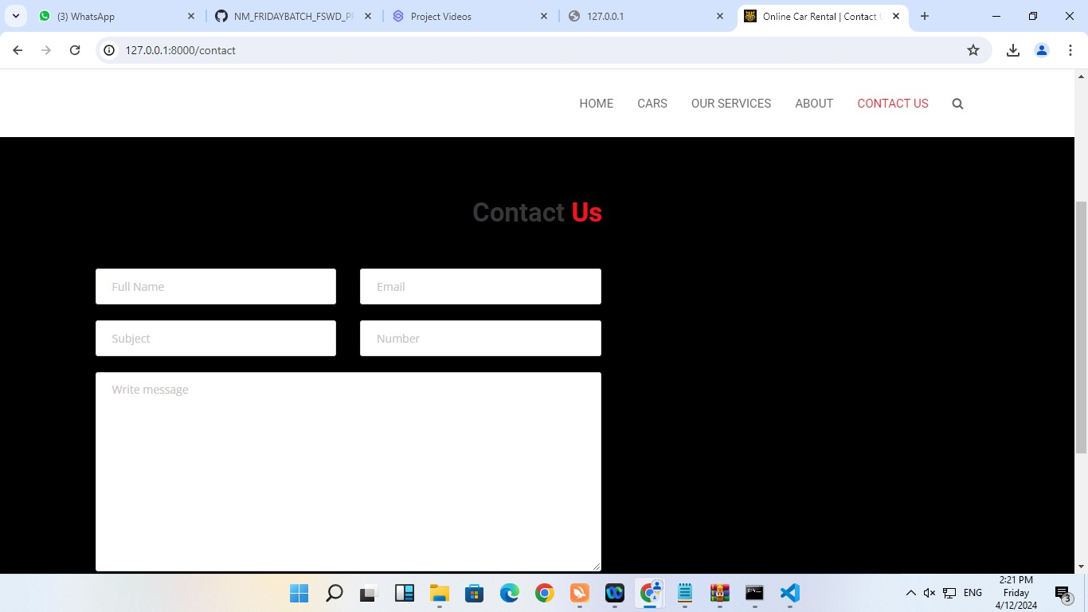
Blog-Page

Slide 16
Future Enhancement:
GPS Tracking: Add a feature that lets users track their rented car's location in real-time, giving them peace of mind and added security.
Social Media Integration: Allow users to share their rental experiences on social media, helping to spread the word and attract new customers.
Voice Search and Chatbots: Make it even easier for users to find and book rental cars by adding voice search and chatbot features.
Demand Forecasting: Use data to predict when rental cars will be in high demand, helping rental agencies manage their fleet better and offer competitive pricing.

Slide 17
Conclusion
The Car Rentals Application built with Django Framework offers a user-friendly and efficient platform for users to browse, book, and manage rental vehicles with ease. By leveraging Django's robust features and flexibility, the application provides a seamless experience for both rental agencies and customers. With features such as user authentication, vehicle management, booking systems, and payment integration, the application streamlines the rental process and enhances user satisfaction. Future enhancements like GPS tracking, demand forecasting, and personalized recommendations further improve the application's functionality and competitiveness in the market.
Source :

Slide 18
Thank You!
Notes:
Thank You !!

